Slide 1
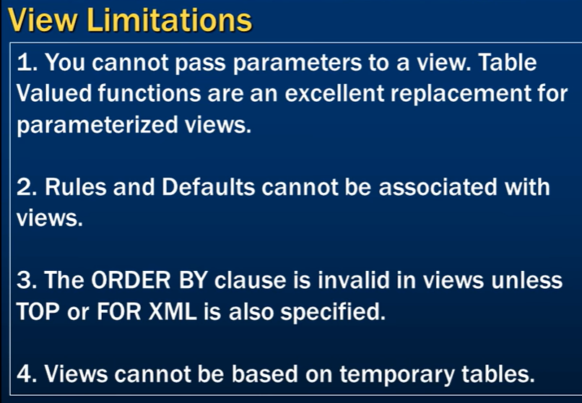

Slide 2
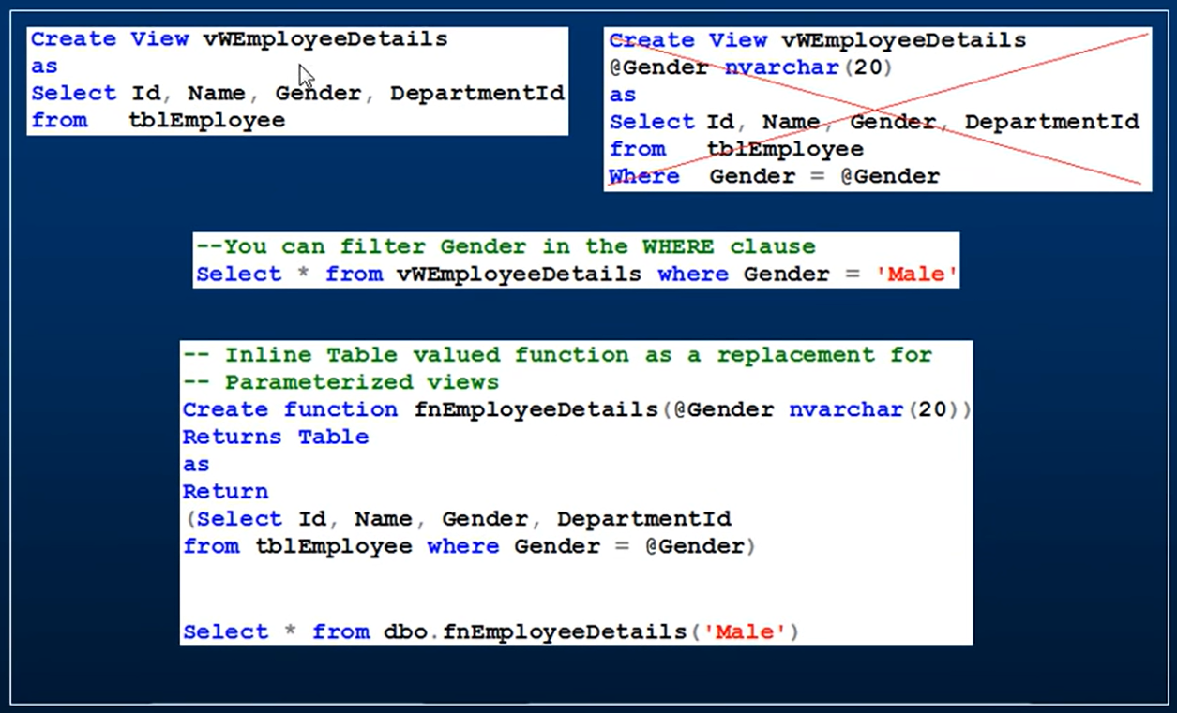
Limitation 01

Slide 3
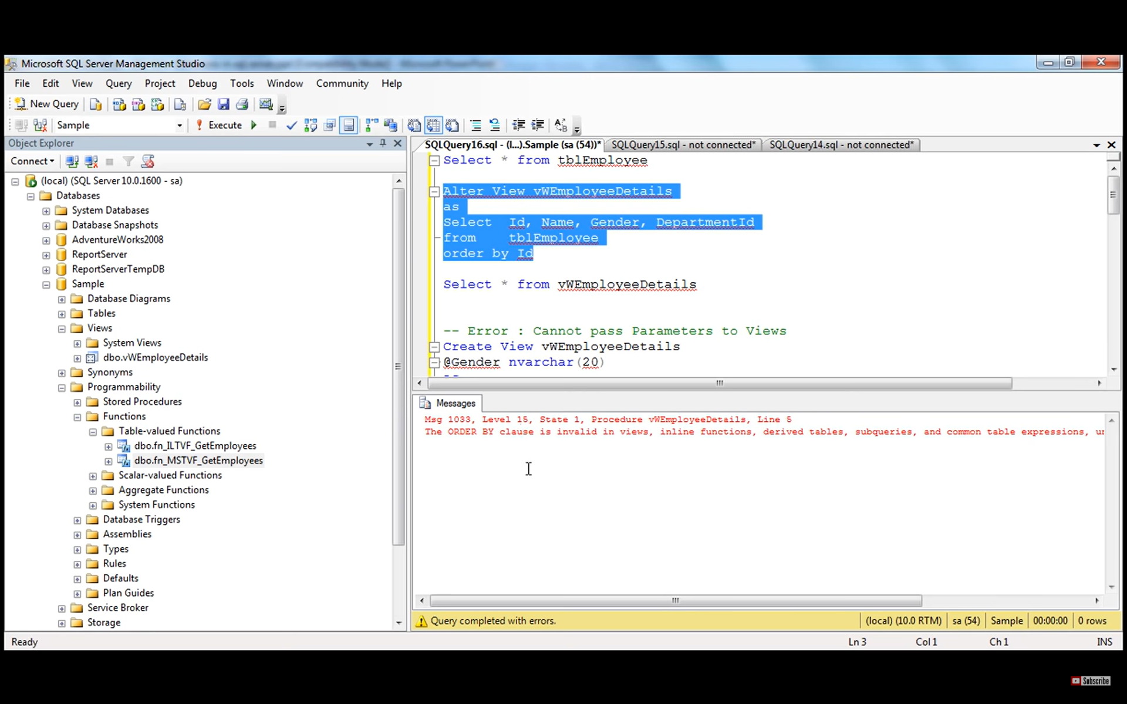
Limitation 03

Slide 4
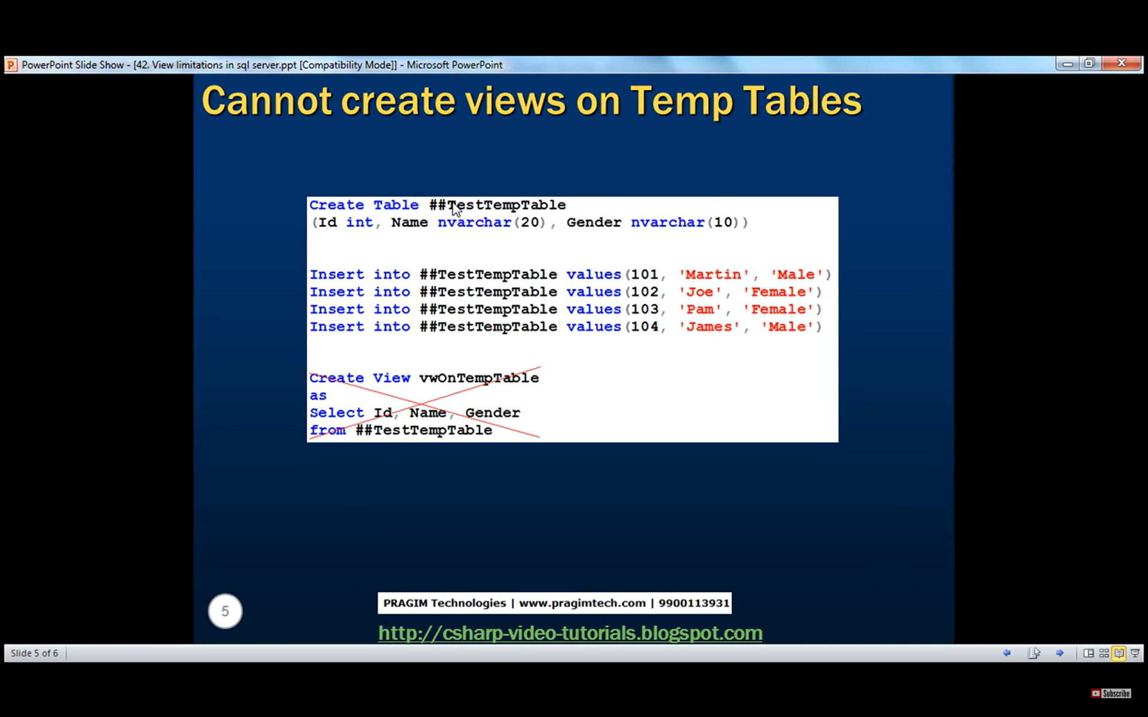
Limitation 04
# :-> Local temporary table
## :-> Global temporary table

